Slide 1
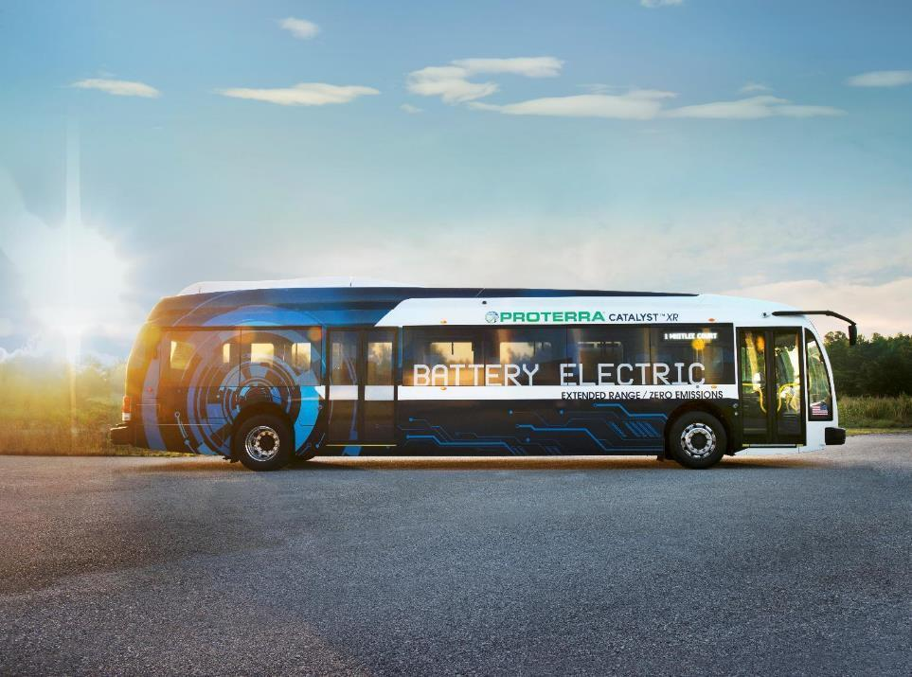
Democratizing Transportation to Foster Social Mobility & Civic Equality
Dale Hill, Founder, Proterra
Pennsylvania Public Transportation Association

Slide 2
A VISION
Clean, quiet transportation for all

Slide 3
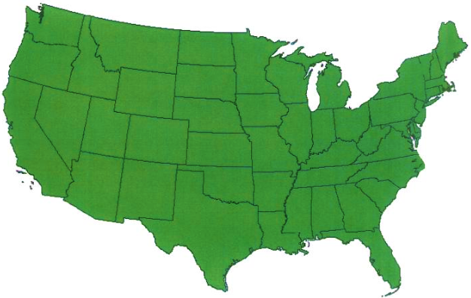












ABOUT PROTERRA
Founded in 2004
Offices and manufacturing in CA and SC
200 employees, strong executive management team
Backed by industry-leading VC and corporate investors
16 customers; 155 firm orders; 312 contracted options
>60 vehicles delivered; >2,00,000 service miles
>8,300,000 pounds of C02 emissions avoided
All-American Company
Strong Executive Team
Solid Financial Backing

Slide 4
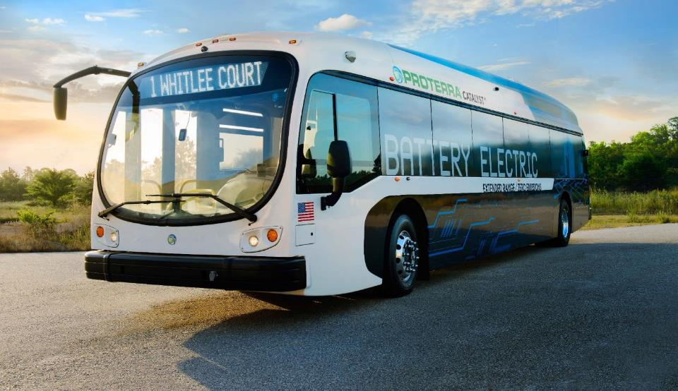
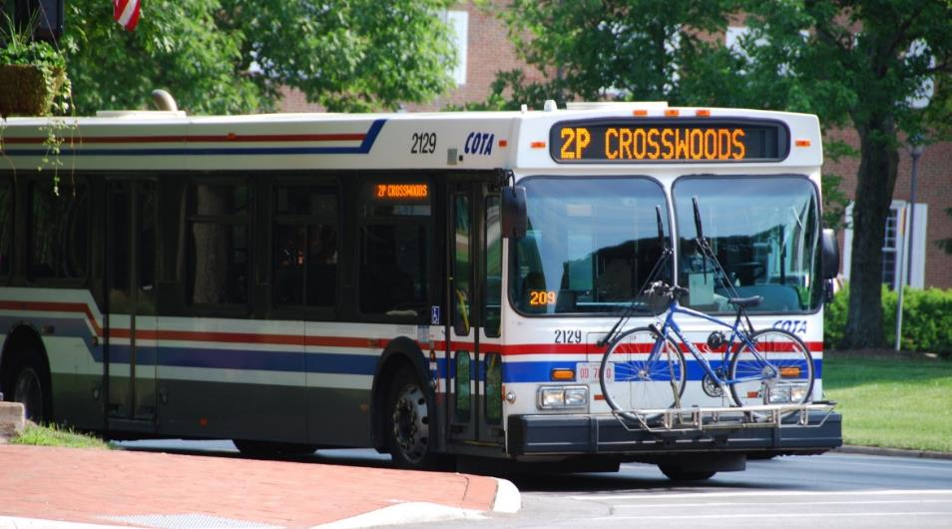
THE WORLD OF TRANSIT IS CHANGING

Slide 5
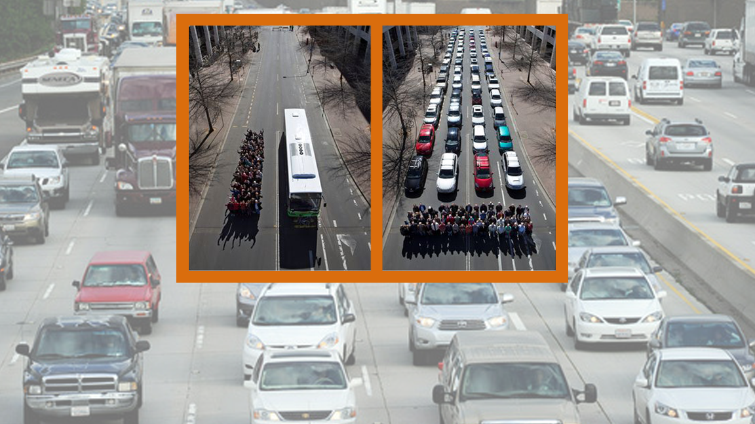
Land. They aren’t building it anymore.
Mass transit solves congestion.

Slide 6
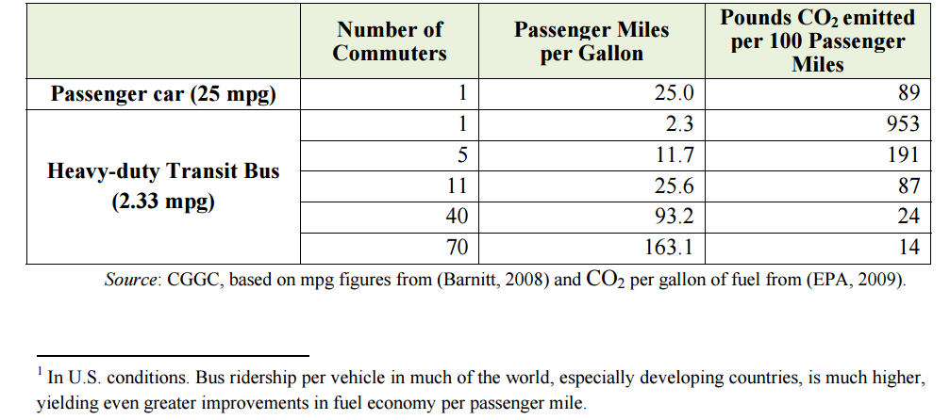
FUEL SAVINGS AND CO2 REDUCTIONS, BUS TRANSIT V. CARS

Slide 7
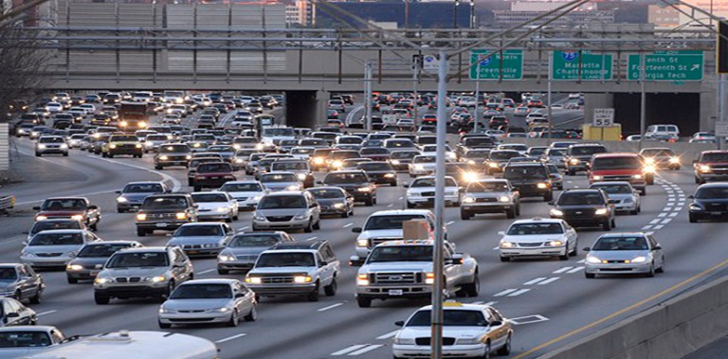
URBANIZATION
BY 2050
75%
OF WORLD’S
POPULATION WILL
LIVE IN CITIES
1M
NEW PEOPLE MOVE
TO URBAN AREAS
EVERY WEEK
Source: Out of the Mountains, David Kilcullen
WE ARE LIVING IN THE CENTURY OF THE CITY

Slide 8

After a brief period of suburbanization,
the U.S. is returning to its Cities

Slide 9
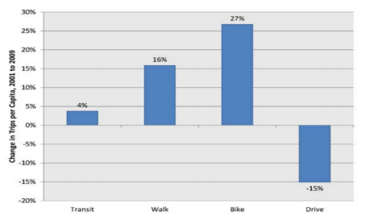
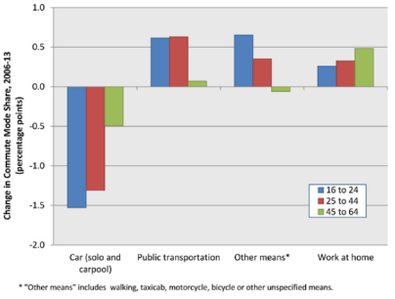
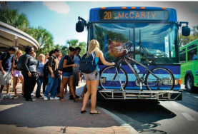
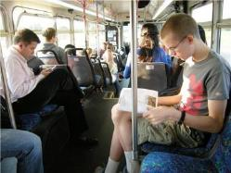
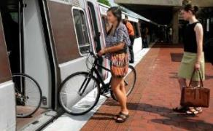
MILLENNIALS: INCREASING LOVE FOR TRANSIT
Change in number of trips per capita among 16 to 34 year olds
Change in commute mode share by age group

Slide 10
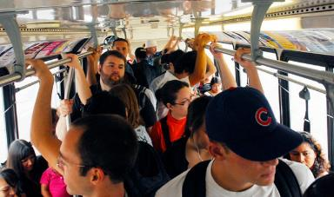
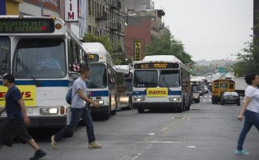
A DILEMMA
More people
More transit
More buses

Slide 11

Total fuel consumed by buses per year:
Diesel fuel:
389,600,000 gallons
CNG fuel:
150,000,000 gallons
Total GHG per year:
From diesel buses: 12,500,000,000 lbs
From Natural Gas buses: 4,600,000,000 lbs
More cities = more transit.
More transit = more pollution?

Slide 12
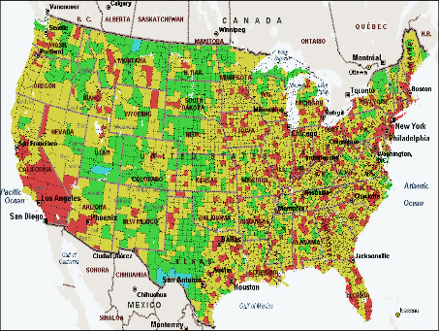
MILLENNIALS: INCREASING LOVE FOR TRANSIT
THE HEALTH COSTS OF FOSSIL FUELS
Annual Diesel Health Impacts in the US (Number of cases in 2010)
Premature Deaths | 21,000
Lung Cancer Deaths | 3,000
Hospital Admissions | 15,000
Emergency Room Visits for Asthma | 15,000
Non-fatal Heart Attacks | 27,000
Asthma Attacks | 410,000
Chronic Bronchitis | 12,000
Work Loss Days | 2,400,000
Restricted Activity Days | 14,000,000

Slide 13
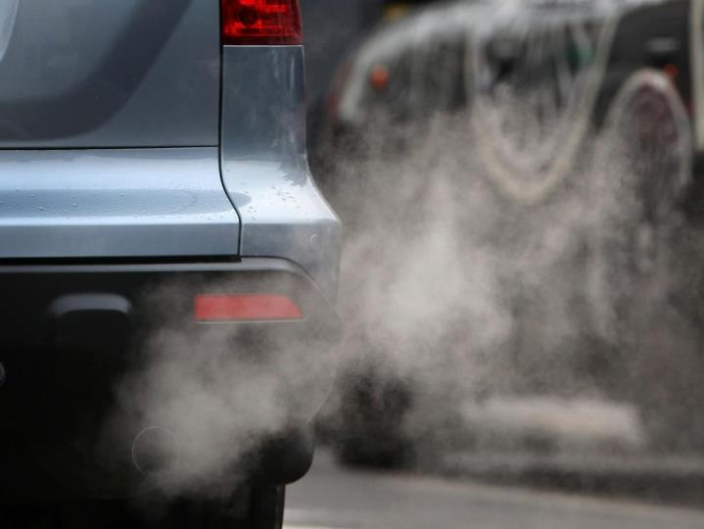
To a disproportionate degree, low-income and underserved communities are exposed to the atmospheric pollutants of urban transportation infrastructure
These communities can neither afford the luxury of energy intensity nor the health and environmental costs of its externalities

Slide 14
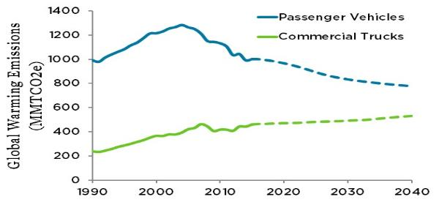
COSTS AND IMPACTS OF HEAVY DUTY EMISSIONS MUST BE ADDRESSED
HEAVY DUTY VEHICLE EMISSIONS MUST BE ADDRESSED
“The biggest reason for the continued increase in emissions from the heavy-duty sector is the simple fact that truck efficiency has remained stuck in the 1970s at about 6 miles per gallon.“
(1990-2011 data from EPA; 2012-2040 data from EIA)

Slide 15
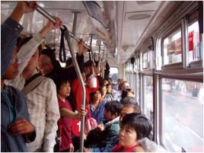

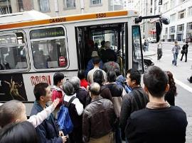
INCREASED DEMAND MEANS RISING CAPITAL AND OPERATING COSTS
“Despite more and more people riding transit, more young people forgoing cars and growing urban populations, commuters all over the country are waiting longer for crowded buses and trains, if they come at all, and paying higher fares in many places.
If we fail to deal with this continuing record growth in ridership, there will be an even more serious national crisis facing our nation’s already overcrowded and cash-strapped transit systems.”
– Larry Hanley, president of the Amalgamated Transit Union

Slide 16


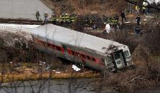
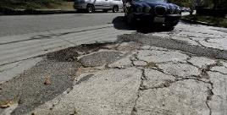
FAST ACT DOLLARS NOT KEEPING UP WITH DEMAND
Stabilizes the federal contribution for five years and adds some funds
Revenue increases make modest inroad to impact huge backlog of needed transportation project investments
States will need to come up with more money to keep up with FAST Act matches,
Still a challenge to find enough revenue to make the kind of improvements their residents and their economies need

Slide 17

WHAT IS THE SOLUTION?

Slide 18
CATALYST 40’ TOTAL COST OF OWNERSHIP ADVANTAGE
MAINT.
FUEL
VEHICLE
--- est. over 12 year lifetime / $ in thousands, except TCO $’s/mile ---
Battery-electric vehicles have the lowest operational lifecycle cost:
High EV energy efficiency, low electricity rates, and high annual vehicle mileage combine to create significant fuel savings
30% fewer parts dramatically reduce maintenance and operating costs
Electricity prices far more stable and predictable than volatile fossil fuel prices
12-yr Operational
Savings per Bus
$448k vs. Diesel
$459k vs. Hybrid
$408k vs. CNG
Notes:
Assumptions (+source):
36,000 annual miles driven
Proterra Bus pricing based on a Catalyst XR 8-pack configuration
12-year lifetime
3.86 MPG Diesel (Source: DOT Transit bus Lifecycle analysis)
3.27 MPG CNG (Source: DOT Transit bus Lifecycle analysis)
5 MPG Hybrid (Source: DOT Transit bus Lifecycle analysis)
1.7 kWh/mile (Altoona testing)
Fuel
$3.5 /DGE Diesel (US EIA Projections - Annual Energy Outlook 2015, 12-year average forecast)
$2.2/ GGE CNG (US EIA Projections - Annual Energy Outlook 2015, 12-year average forecast. Does not include compression charges)
$3.5/DGE Hybrid (US EIA Projections - Annual Energy Outlook 2015, 12 year average forecast.)
$0.11/ kWh (Source: EIA TABLE 5.3 Average retail price of electricity to ultimate customer, 10 year future forecast)
*Maintenance:
$0.90/ mile Diesel
$1.00/mile CNG
$0.55/mile Proterra
$1.1/mile Hybrid
(*maintenance costs are all based on customers data)

Slide 19
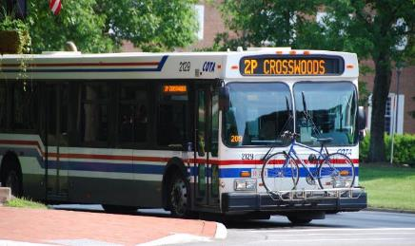
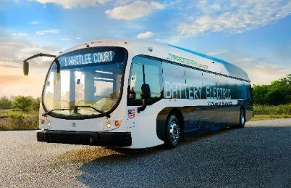
LONGER LIFE SPAN
Vs.
12 years
18 years+

Slide 20
COMPOSITE BODY STRUCTURE: CARBON FIBER REINFORCED
Layered composite material is superior to steel:
• Stronger and more durable
• Corrosion-resistant; no rusting or deterioration
• Lighter weight
• Easier to maintain and repair
• Reinforced with carbon fiber at load-bearing points

Slide 21
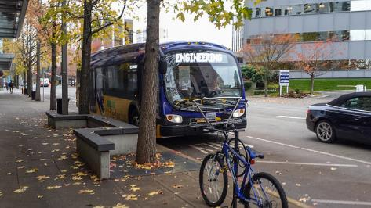
INCREASED RELIABILTY MEANS HIGHER USEAGE; LESS DOWN TIME
Recently conducted most thorough EV test in U.S. that proved Proterra EV transit vehicles meet rigors of strenuous continuous usage

Slide 22
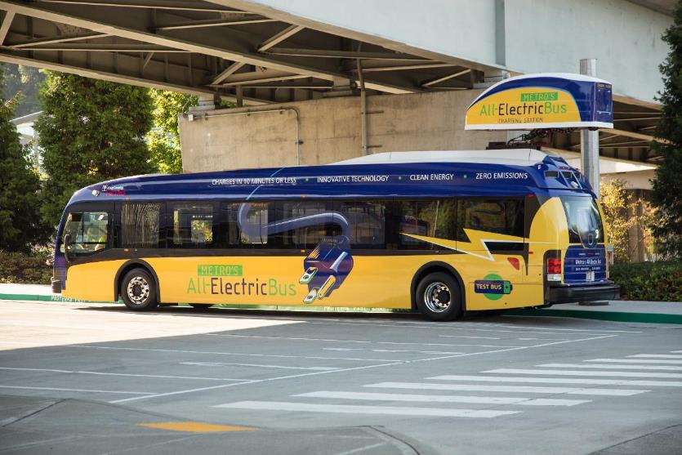
KING COUNTY METRO VEHICLE TEST: 10/17/15 TO 01/31/16

Slide 23

KING COUNTY METRO VEHICLE TEST: 10/17/15 TO 01/31/16

Slide 24
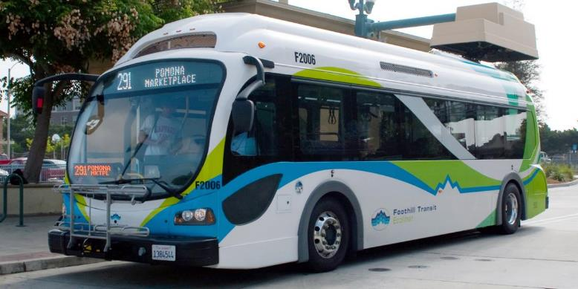
LESS DOWN TIME; HIGHER USAGE
For a fleet of 100 buses for every 1% increase in reliability, Proterra provides the equivalent of one extra bus on the road
National Renewable Energy Laboratory (NREL) report indicated a 93% fleet availability for Proterra first-generation bus over a 14-month test

Slide 25
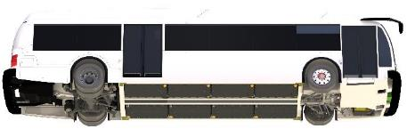


ABILITY TO ADAPT TO NEW TECHNOLOGIES BY ONLY CHANGING BATTERY PACKS
Each
Proterra Catalyst™
vehicle can be configured
with the ideal type and
number of battery packs to
fit an existing route, and
later reconfigured to serve
different routes as
needs change.
Under-Body
Battery Location
Easy access
Safest placement
Better handling
Battery pack design
Interchangeable
Upgradable
Ruggedized
4-10 battery packs/ vehicle
TerraVolt FC
TerraVolt XR
The Proterra TerraFlex™ Energy Storage System offers a choice of two battery packs
Battery Type | TerraVolt FC | TerraVolt XR
Battery Chemistry | LTO (Lithium Titanate Oxide) | NMC (Nickel Manganese Cobalt Oxide)
Charge Rate | up to 500 kW | up to 100 kW
Energy Density | 13.1 kWh/pack | 32.1 kWh/pack
Configuration Options | 53-131 kWh | 128-321 kWh
Notes:
Use Bobby’s tech slides as deeper-dive backup
Rugged TerraPak™ reinforced battery enclosures
Choice of fast-charge TerraVolt™FC battery pack
Or TerraVolt™XR extended-range battery pack
Easy access for changing configurations
Modular design ensures perfect fit
Plug-and-play interoperability
Easy technology upgrades
Ultimate flexibility
Range extension
Safest location

Slide 26
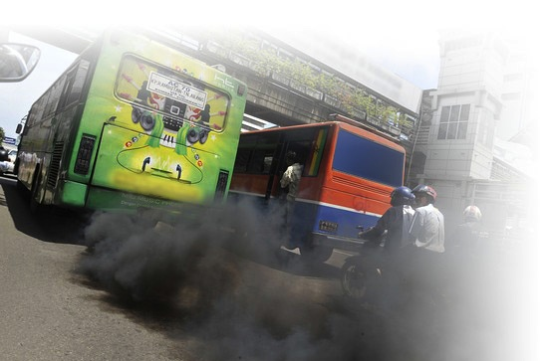
SO LET’S TALK ABOUT POLLUTION
More buses mean more pollution which means more health issues and increased medical costs

Slide 27
DON’T EVEN COMPARE TO EV CNG AND DIESEL C0₂ NO COMPARISON TO EV
100+%
Tailpipe Emissions
Annual lbs C0₂
D=Diesel, DH=Diesel Hybrid, CNG= Compressed Natural Gas, Pro=Proterra EV

Slide 28
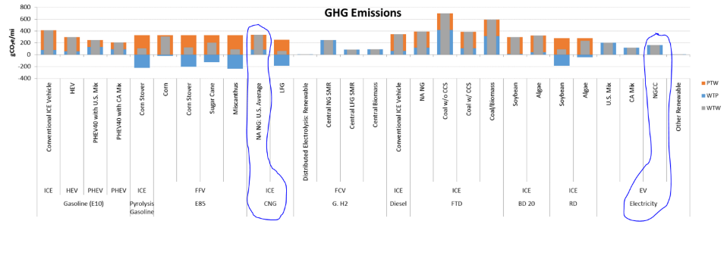
A BATTERY-ELECTRIC BUS USES ELECTRICITY FROM FOSSIL FUELS
To be good stewards of our remaining fossil fuels, use CNG wisely.

Slide 29
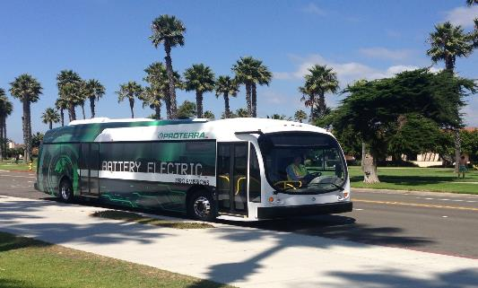
TIME TO REIMAGINE
BUS TRANSIT
CLEAN
QUIET
LIGHT
SPACIOUS
COST EFFICIENT
EASY TO MAINTAIN

Slide 30
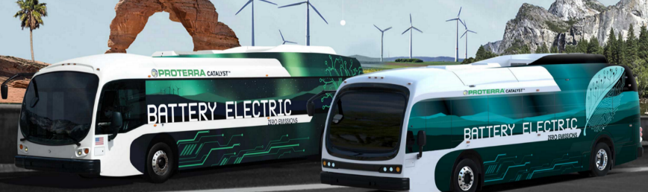

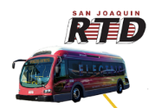
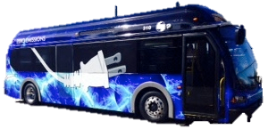
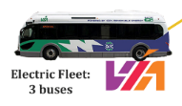

HOW DO WE MOTIVATE THE NON-TRANSIT USER: DISTINCTIVE APPEARANCE

Slide 31
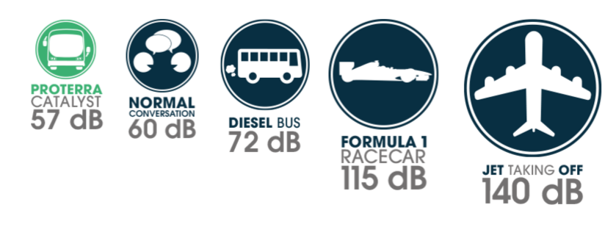
HOW DO WE MOTIVATE THE NON-TRANSIT USER: QUIET
Along with zero-emissions and outstanding fuel economy, the Proterra Catalyst is exceptionally quiet and creates virtually no noise while stationary. In motion, it’s whisper quiet and operates below a normal conversation level, ensuring that the communities and neighborhoods we serve remain undisturbed.

Slide 32
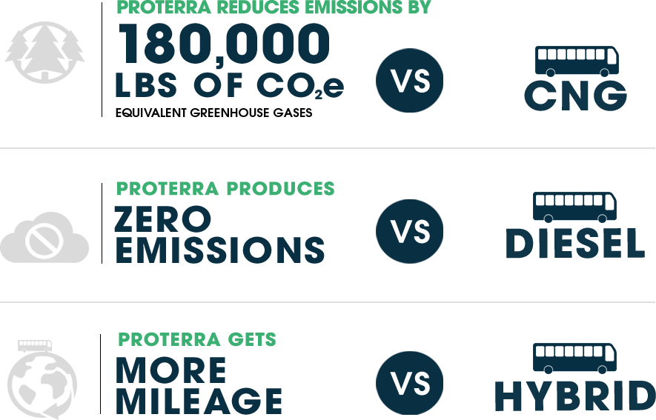
HOW DO WE MOTIVATE THE NON-TRANSIT USER: NO EMISSIONS

Slide 33
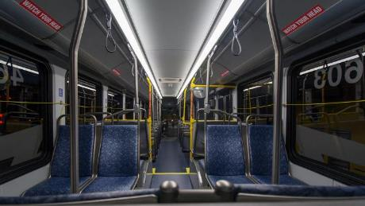
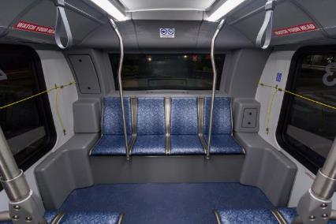
HOW DO WE MOTIVATE THE NON-TRANSIT USER: MODERN INTERIOR

Slide 34

ELECTRIC BUSES: DEMAND AND EFFICIENCY ON THE RISE
  What previously appeared to be an attractive niche market now has the potential to be the entire market in < 10 years
  The limitations of energy storage technology in performance and cost are disappearing, the need for infrastructure and behavioral change will be minimal
  It is now possible – without any scientific technical risk – to develop a product that disruptively outperforms combustion in transit
  This market may be more of a disruption than an orderly substitution; step-change volume growth
  Proterra broke four performance records at Altoona

Slide 35
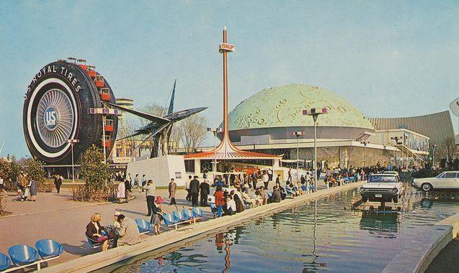
WHAT DOES THE FUTURE OF TRANSIT LOOK LIKE?
In 1964, the vision for transportation and transit looked like this…but for us now…

Slide 36

FLEETS WILL USE COMPLETELLY CLEAN ENERGY
  By 2030, California’s power sector may be 50% renewable energy, enabling massive solar and storage growth
  Other states looking to follow California’s lead

Slide 37
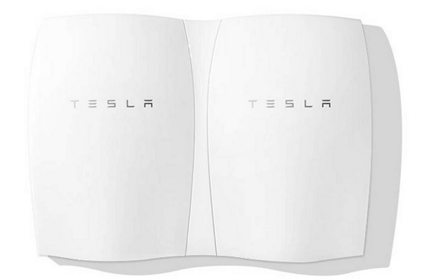
ENERGY WALLS ALLOW OFF-THE-GRID CHARGING

Slide 38
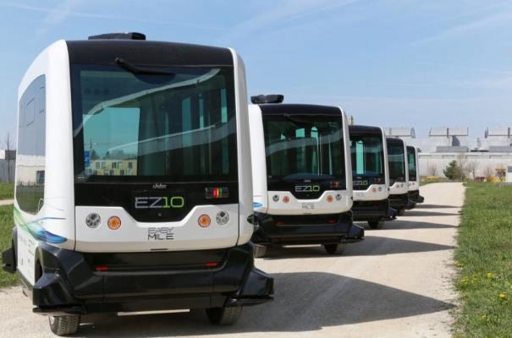
DEPLOYMENT OF AUTONOMOUS BUSES ON THE HORIZON
They are already a reality in California via the Contra Costa Transportation Authority that put them in use at the 585-acre Bishop Ranch business park in San Ramon, California and also use them at the GoMentum road test site at the former Concord Naval Weapons Station.

Slide 39
EV ECONOMICS IMPROVING RAPIDLY
U.S. ELECTRIC VEHICLE SALES (000s Units)
LITHIUM ION BATTERY COST ($/kWh)
850
$1,200
+ Other cost
reductions
across
EV BOM
275
$300
  Scale in EV is driving down battery and component costs
  Proterra leverages technology gains of entire EV industry
Sources: Navigant Research, green.autoblog.com, Electric Drive Transportation Association.

Slide 40
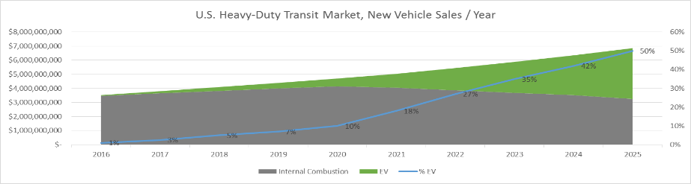
HEAVY DUTY EV MARKET TIMING
With the latest 5-Year Transportation Bill (FAST Act) and the California ARB programs (Cap & Trade, Advanced Clean Transit Regulation) the next five years will enable EV to scale-up, cost-down and dominate the market
EV can climb the experience curve and resoundingly beat internal combustion
Federal “Lo-No” Funding (part of FAST Act) is accelerating the market by encouraging agencies to apply for the cost-premium of EV technology, versus the entire purchase
The potential transition:

Slide 41
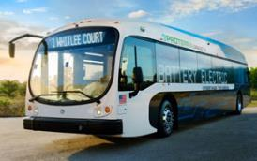
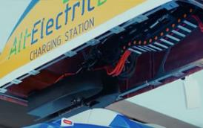
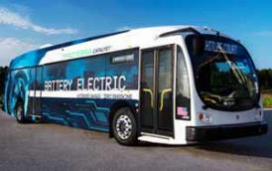
CHANGING MARKET DYNAMICS MEAN IT’S 100% THE RIGHT SPACE
Market Signals
  The market for medium and large hybrid and pure electric buses will be over $72 billion in 2025
  A city with half a million inhabitants would save about US $12 million per year if the city’s buses ran on electricity instead of diesel, according to an analysis conducted by KPMG

Slide 42
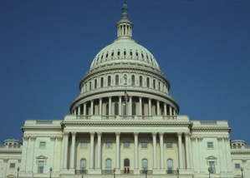
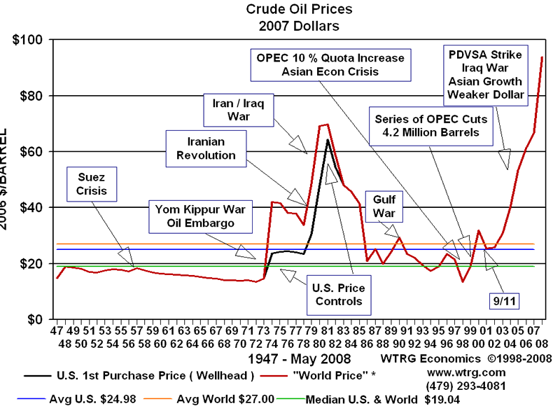
TIMING IS RIGHT – THIS IS THE WINDOW
Macro Environment
North American transit capital expenditures are cyclical
  Transit CAPX has been behind schedule for years, leading to average vehicle age creeping up to 9 years
We are entering a growth phase of the capital cycle, driven by new, long-term federal funding that finally passed into law
This is an ideal time to turn-over fleets to new technology, and local policy will accelerate EV
  California (1/7 of the US Market) focused on zero emission through a variety of programs, some of which will exceed FTA zero emission funding on an annual basis
  Washington State, Oregon, New York, Chicago continue to lead as well
  Individual Cities and mayors taking a lead of smart city and environmental initiatives
Oil prices remain depressed
  Yet we aren’t experiencing any lack of interest in EV technology
  Some customers seem interested in re-investing their fuel savings in EV, and none of them believe cheap oil is durable

Slide 43
NEW REGULATIONS AND POLICIES ACCELERATING EV ADOPTION
CA Gov. 2015 Exec. Order to reduce GHG emissions by 40% and petroleum use by up to 50% by 2030
$2.2B available in Cap and Trade funding; CA Gov. recently allocated $350M for Low Carbon Transportation to Air Resources Board (up from $200M)
  Add’l $5M for HVIP Program (total of $12M)
  Add’l $20M for Bus Pilot Deployments (total of $45M; now separate from trucks)
CA Governor increased Low Carbon Transit Operations (LCTOP) from proposed $50M to $100M; will provide operating and capital assistance to reduce GHG emissions and improve mobility; priority on serving disadvantaged communities
CA 2015 ZEV Action Plan calls for expansion of use of zero-emission buses in public transportation; possible tax relief on purchase of heavy duty ZEV
ARB’s Advanced Clean Transit Rule - goal of complete fleet transition to zero emission technologies by 2040; bus mandate to start in 2018; for first time, acknowledged electric buses are ahead of fuel cell buses on commercialization readiness and that CNG technology is an interim solution
CEC has two significant funding programs: (i) AB 118 - ~$100M each year for vehicle deployment, mfg. and charging infrastructure; (ii) EPIC program - ~$162M each year to fund applied research and development, technology demonstration and deployment for clean energy technologies
Federal 5339 C Low-No Funding; $26 million in 2016, > $50 million per year 2017 – 2022

Slide 44
WITH NEW TECHNOLOGIES, THE FUTURE WILL LOOK LIKE THIS
Fuel that costs 20% of today’s fuel prices
Buses that last 50% longer
Buses that have a fleet availability 3-5% greater than current incumbent technology
Autonomous buses in limited areas reducing demand for drivers
A transit system in the U.S., that moves twice the number of people as today— at the same overall cost as today—with zero tailpipe emissions

Slide 45
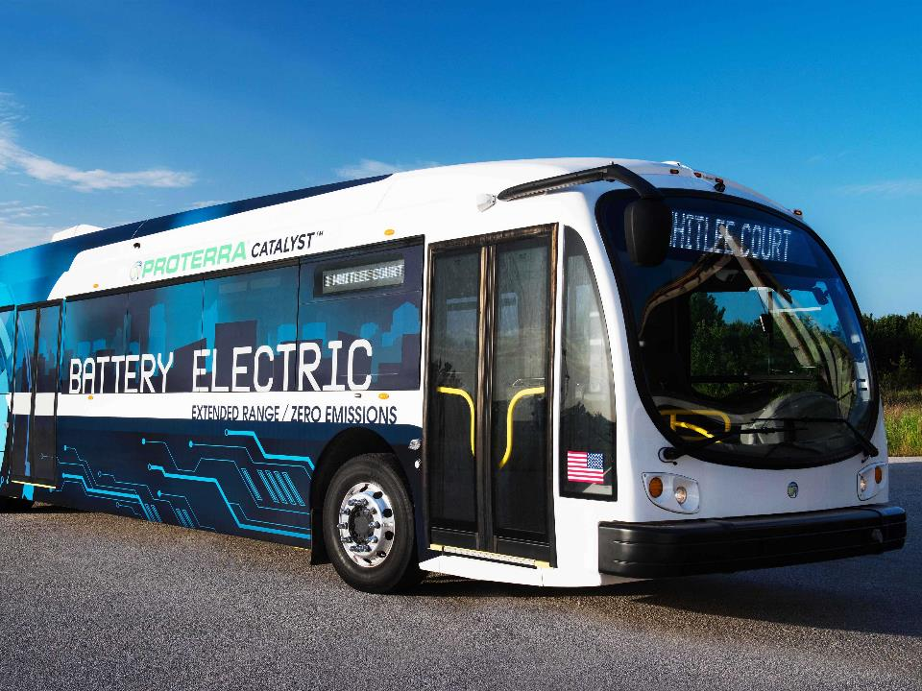
EV for Everyone

Slide 46
THANK YOU!
Dale Hill, Founder, Proterra

